Slide 1

H1N1 Vaccine Prediction Using Machine Learning
7PAM2015-0509-2025 - Research Methods In Data Science
Group project - Data Science Challenge
Group N : 23096901 - Ravi. Pranusha, 23091055 - jagan satwik pinnam reddy , 23096047 - Varun Paka ,
23100228 - Nasar Reddy Naru , 23103084 - Shashank Shivakoti
GitHub Link
Google Collab Link

Slide 2
Problem Statement and Objective
Problem Statement
H1N1 influenza can have serious public health impacts.
Understanding vaccination behavior can improve public health planning.
Predict whether an individual received the H1N1 vaccine.
Project Objective
Explore the dataset.
Apply preprocessing techniques.
Train and compare 5 machine learning models.
Select the best-performing model.
Use SHAP for model explainability.

Slide 3
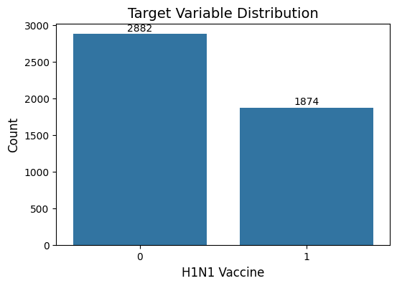
Dataset Overview & Exploratory Data Analysis
Dataset Summary
Feature Categories
Attribute | Value
Total Records | 4,756
Total Columns | 31
Predictor Features | 29
Target Variable | h1n1_vaccine
Problem Type | Binary Classification
Feature Type | Count
Binary Features | 12
Ordinal Features | 7
Categorical Features | 10
Target Distribution h1n1_vaccine | %
0 | 60.59 %
1 | 39.40 %
The dataset is moderately imbalanced but still suitable for classification.

Slide 4
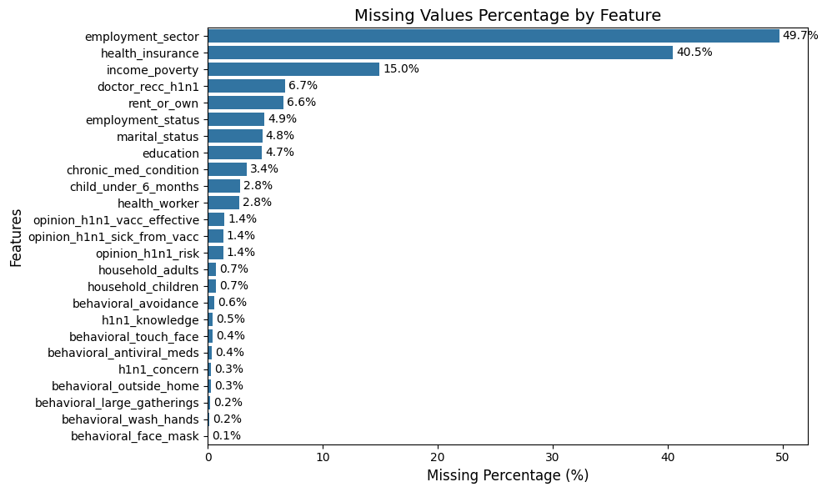
Missing Values Analysis
Key Findings
Employment Sector had the highest missing rate (49.7%).
Health Insurance contained 40.5% missing values.
Income Poverty had 15.0% missing values.
Most remaining features contained less than 10% missing data.
Challenge
Several features contained incomplete observations.
Missing data can introduce bias and reduce predictive performance.
Solution
Binary, ordinal and categorical features were treated separately.
Appropriate imputation techniques were applied before model training.

Slide 5
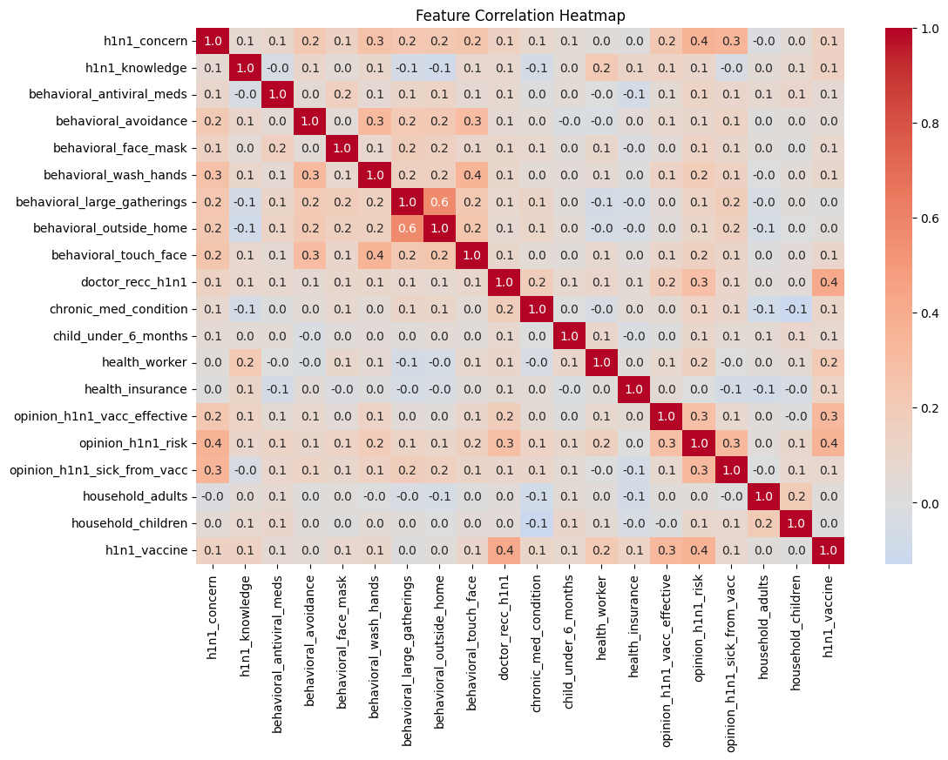
Correlation Analysis
Key Findings
Most feature correlations were weak to moderate, indicating low multicollinearity.
Doctor recc h1n1 showed one of the strongest positive correlations with vaccination status (0.4).
Opinion h1n1 risk and opinion h1n1 vacc effective were positively associated with vaccine uptake.
behavioral large gatherings and behavioral outside home showed a relatively strong relationship (0.6), suggesting similar preventive behaviors.
No highly correlated feature pairs were identified that required removal from the dataset.
Importance
Helps identify relationships between variables before modelling.
Detects potential multicollinearity that could affect model performance.
Provides insights into factors influencing vaccination behaviour.
Supports feature interpretation and validates model findings.

Slide 6
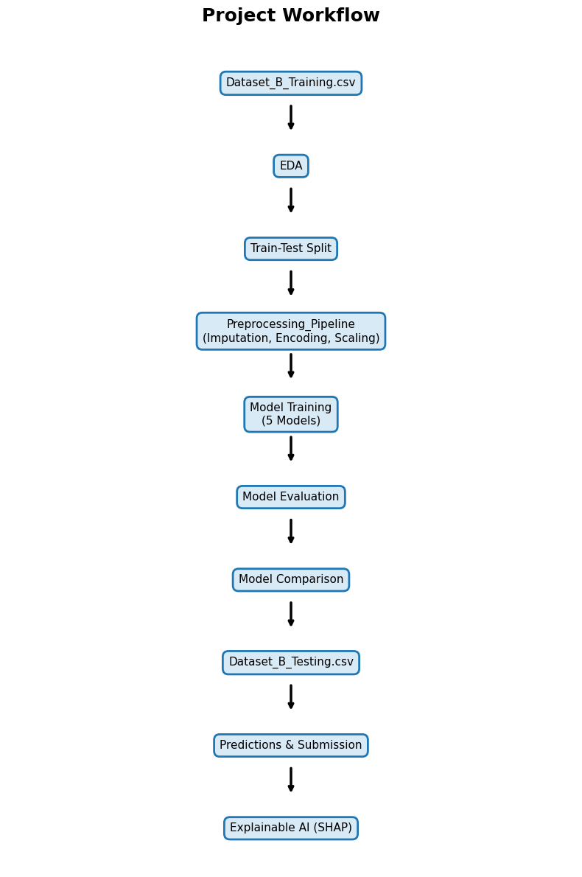
Project Workflow
Key Activities
Performed EDA, target distribution analysis and correlation analysis.
Handled missing values using Mode Imputation and KNN Imputation.
Applied One-Hot Encoding and Standard Scaling through a preprocessing pipeline.
Trained and compared five models:
Logistic Regression
Random Forest
XG Boost
Tuned XG Boost
Gradient Boosting
Evaluated models using Accuracy, Precision, Recall and F1 Score.
Generated predictions for Dataset_B_Testing.csv and created submission files.
Applied SHAP Explainable AI to interpret model predictions.

Slide 7
Machine Learning Models
Models Evaluated
Model | Category | Purpose
Logistic Regression | Linear Model | Baseline Performance
Random Forest | Ensemble Learning | Reduce Overfitting
XG Boost | Boosting Algorithm | Improve Predictive Power
Tuned XGBoost | Optimized XGBoost | Hyperparameter Optimisation
Gradient Boosting | Boosting Algorithm | Sequential Error Reduction
Hyperparameter Tuning
Tuned XG Boost Randomized Search CV was used for optimization.
20 parameter combinations were evaluated.
5-fold Cross Validation was applied.
F1 Score was used as the optimization metric.
Key Activities
Trained five machine learning models.
Compared baseline, ensemble and boosting approaches.
Although Tuned XG Boost uses the same algorithm as XG Boost, different hyperparameter settings resulted in a separate trained model with different prediction behavior.
Selected the best-performing model for prediction generation.

Slide 8
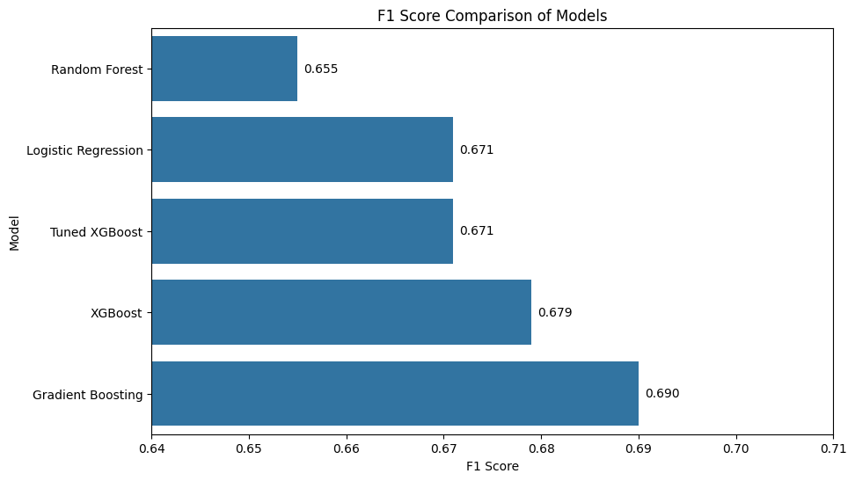
Model Performance Comparison
Key Findings
Gradient Boosting achieved the highest Accuracy (76.7%) and F1 Score (0.688).
XG Boost provided competitive performance and ranked second overall.
Logistic Regression delivered strong baseline performance despite its simplicity.
Random Forest achieved the highest Precision (0.741) but lower Recall reduced its overall F1 Score.
Hyperparameter tuning improved XG Boost cross-validation performance but did not outperform Gradient Boosting on the validation dataset.
Rank | Model | Accuracy | Precision | Recall | F1 Score
1 | Gradient Boosting | 0.768 | 0.727 | 0.653 | 0.689
2 | XGBoost | 0.758 | 0.713 | 0.648 | 0.679
3 | Logistic Regression | 0.759 | 0.727 | 0.624 | 0.671
4 | Tuned XGBoost | 0.755 | 0.713 | 0.635 | 0.671
5 | Random Forest | 0.756 | 0.741 | 0.587 | 0.655

Slide 9
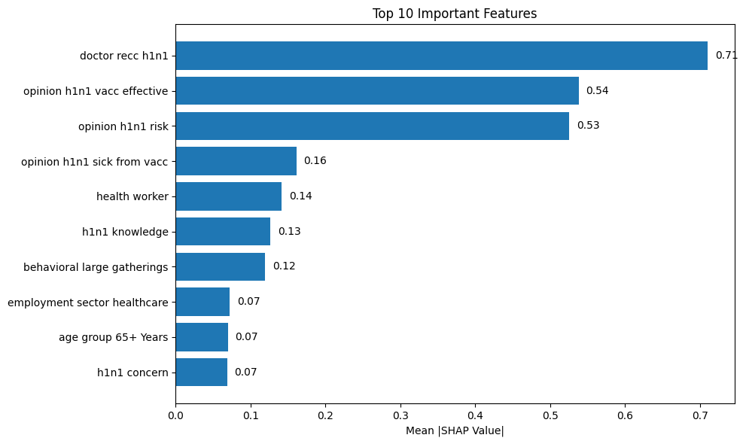
Explainable AI (SHAP)
What is SHAP?
SHAP (Shapley Additive exPlanations) was used to interpret model predictions.
It measures the contribution of each feature to the model output.
SHAP improves transparency and understanding of machine learning models.
Key Findings
Doctor recommendation was the most influential feature.
Perceived vaccine effectiveness strongly influenced vaccination decisions.
Perceived H1N1 risk contributed significantly to model predictions.
Health-related and behavioral factors also affected vaccination likelihood.
Why SHAP Matters
Helps explain model behavior.
Identifies the most influential predictors.
Increases trust and interpretability of predictions.

Slide 10
Conclusion & Future Directions
Key Insights
Doctor recommendation was the strongest predictor of vaccination uptake.
Perceived vaccine effectiveness and perceived H1N1 risk significantly influenced vaccination behavior.
Ensemble learning approaches consistently outperformed the baseline model.
Careful preprocessing contributed substantially to model performance and stability.
Future Directions
Investigate advanced imputation techniques for highly incomplete features such as employment sector and health insurance.
Explore feature engineering techniques to capture additional behavioral and demographic patterns.
Evaluate ensemble stacking and hybrid models to further improve predictive performance.
Extend explainability analysis using local and global XAI techniques for deeper model interpretation.
Final Takeaway
The project demonstrates that combining effective preprocessing, ensemble machine learning models and Explainable AI techniques can produce accurate, interpretable and reliable predictions of H1N1 vaccination behavior.

Slide 11
THANK YOU!

